Slide 1

5th Floor, Usnaz Tower, Church Landing Rd, near Medical Trust Hospital, Pallimukku, Kochi, Kerala 682016

Slide 2
JSon Objects

Slide 3
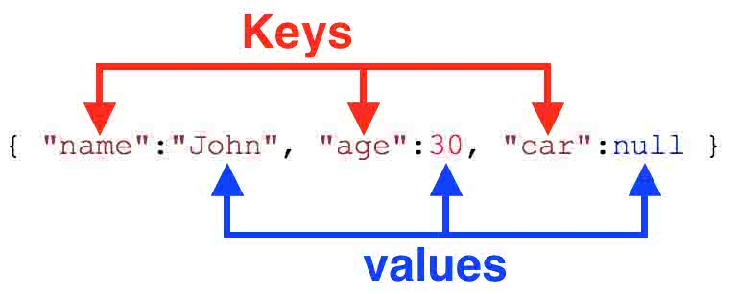
Introduction to JSON in Python
JSON (JavaScript Object Notation) is a lightweight data interchange format that is easy for humans to read and write, and easy for machines to parse and generate. It is widely used in web applications as an alternative to XML. In Python, the json module provides functions for encoding and decoding JSON data.

Slide 4
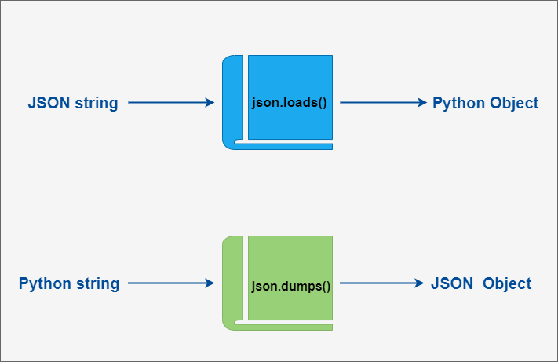
Encoding and Decoding JSON in Python
The json module provides two main functions for working with JSON data: dumps() and loads(). The dumps() function converts a Python object into a JSON string, while the loads() function does the opposite, converting a JSON string into a Python object.
To encode a Python object as JSON, you can pass the object to the dumps() function. By default, it will convert most built-in Python types such as strings, numbers, lists, and dictionaries. However, custom classes and functions will need to be converted manually.

Slide 5
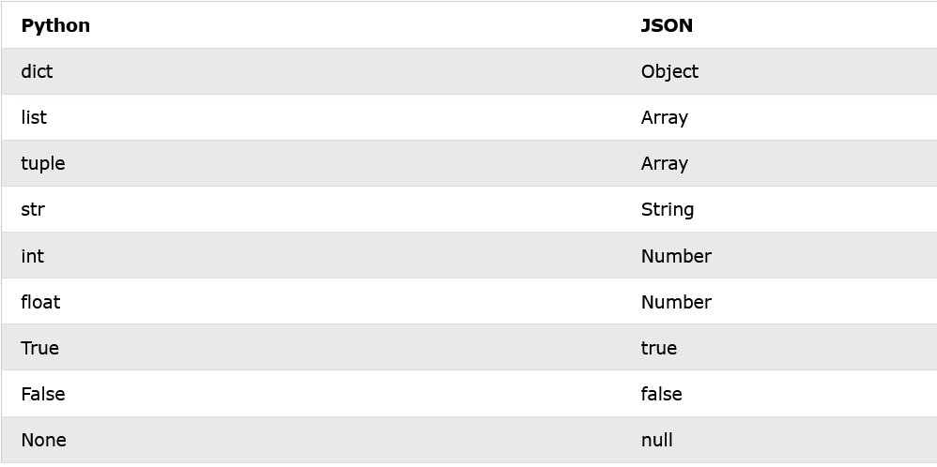

Slide 6
import json
print(json.dumps({"name": "John", "age": 30}))
print(json.dumps(["apple", "bananas"]))
print(json.dumps(("apple", "bananas")))
print(json.dumps("hello"))
print(json.dumps(42))
print(json.dumps(31.76))
print(json.dumps(True))
print(json.dumps(False))
print(json.dumps(None))

Slide 7
Working with JSON Data in Python
Once you have loaded JSON data into a Python object, you can access its properties just like any other object. For example, if you have a JSON object with a 'name' property, you can access it in Python using the dot notation: obj.name.
You can also use loops and conditionals to iterate over JSON arrays or filter objects based on their properties. For more complex operations, you may want to use third-party libraries such as pandas or numpy.

Slide 8
Advanced JSON Features in Python
The json module supports several advanced features for working with JSON data. For example, you can use the cls argument to specify a custom encoder or decoder class for handling non-standard Python objects. You can also use the separators argument to specify custom separators for the output JSON string.
Another useful feature is the indent argument, which specifies the number of spaces to use for indentation when pretty-printing the output JSON string. This can make it easier to read and debug large JSON files.

Slide 9
Best Practices for Using JSON in Python
When working with JSON data in Python, it is important to follow best practices to ensure your code is efficient, maintainable, and secure. For example, you should always validate input JSON data to prevent security vulnerabilities such as SQL injection or cross-site scripting (XSS).
You should also use descriptive variable names and comments to make your code more readable, and handle errors gracefully using try/except blocks. Finally, you should consider using a version control system such as Git to manage changes to your code and collaborate with other developers.

